Slide 1
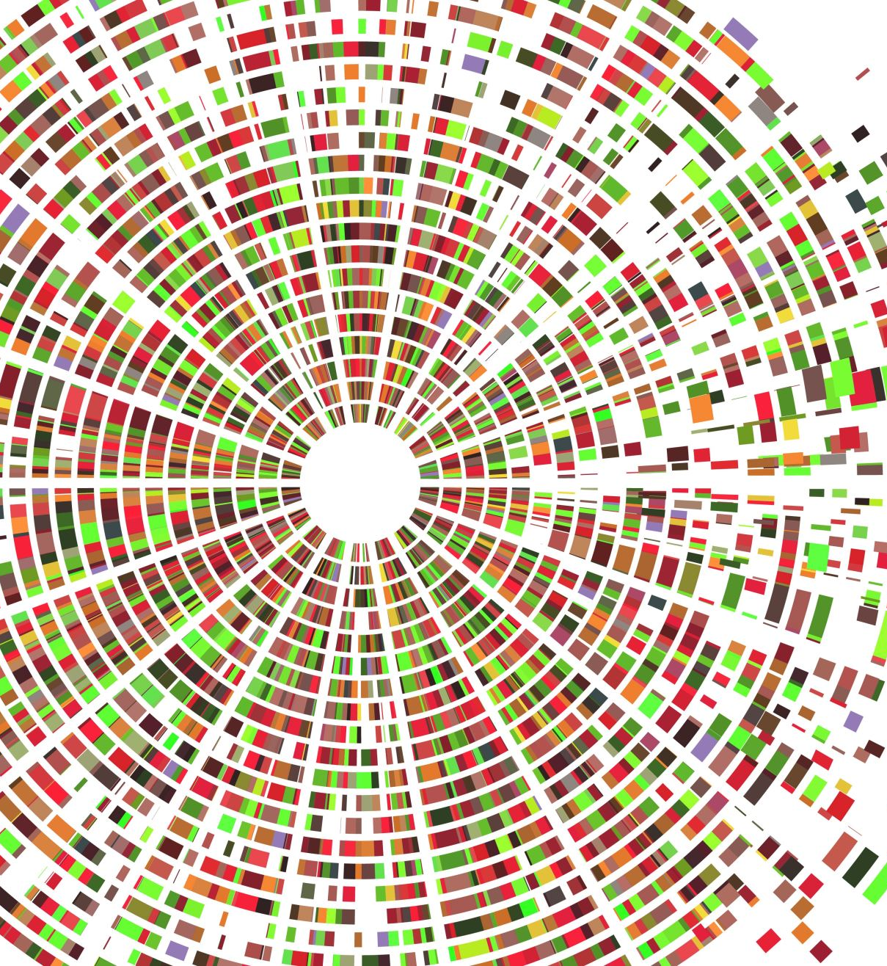
Paint n’ Suffering UML Diagrams
Made by: Christian Garcia

Slide 2
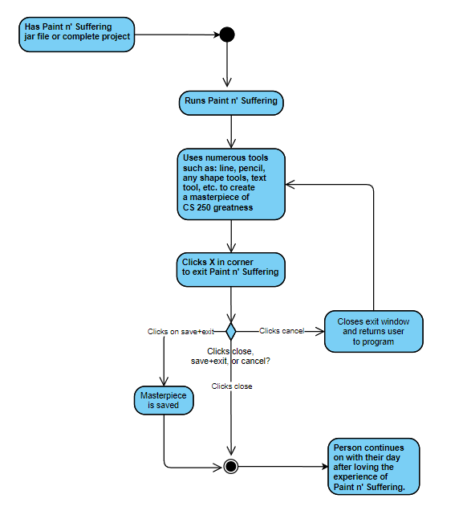
Activity Diagram

Slide 3
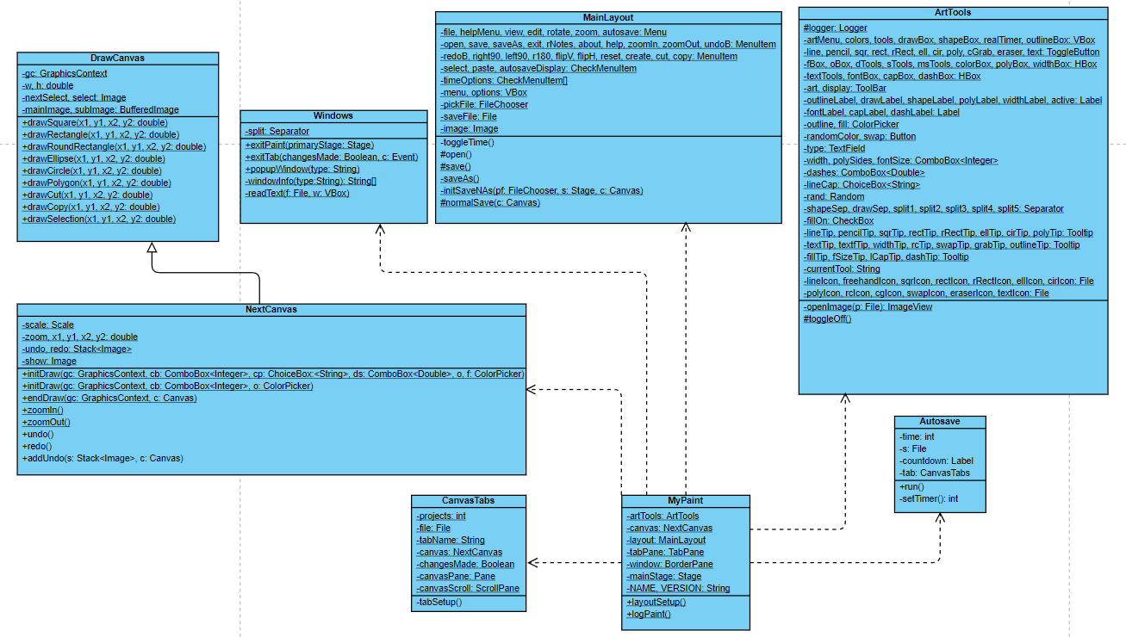
Class Diagram

Slide 4
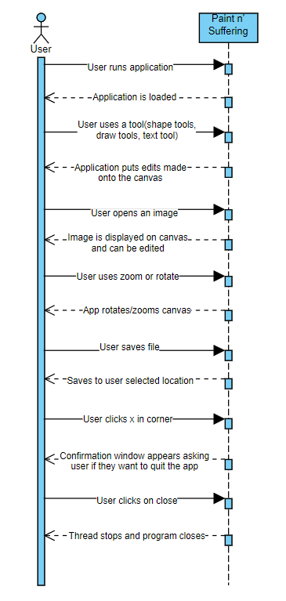
Sequence Diagram

Slide 5
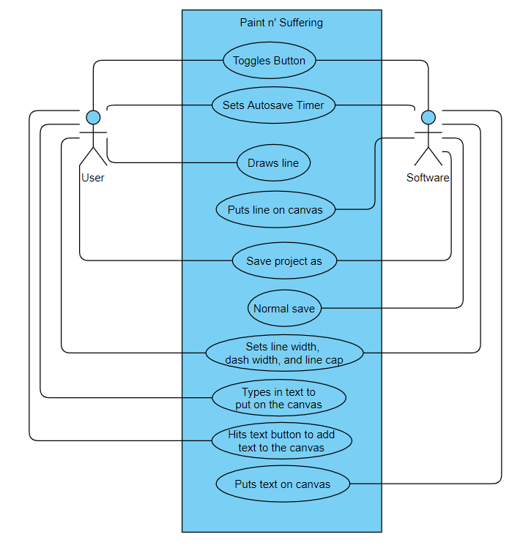
Use Case Diagram

